Slide 1
CAPESTONE PROJECT
GROUP 1 – TEAM 2( AKHIL RAJAN, GYAN PATHAK, SANDEEP S)

Slide 2
DATA ENGINEERING
Data engineering is the practice designing and building systems for collecting, storing, and analyzing data at scale
Data engineering helps make data more useful and accessible for consumers of data
Data engineers work in a variety of settings to build systems that collect, manage, and convert raw data into usable information for data scientists and business analysts to interpret.

Slide 3
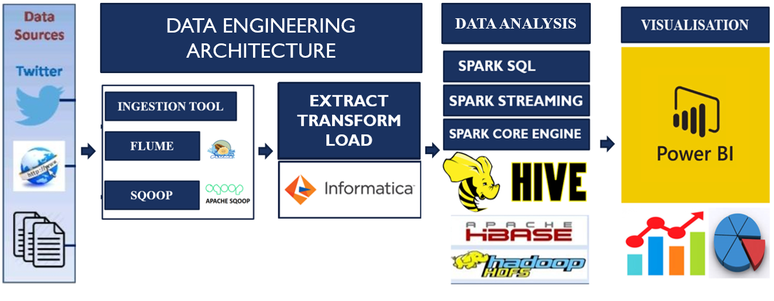
ARCHITECTURE

Slide 4
INFORMATICA

Slide 5
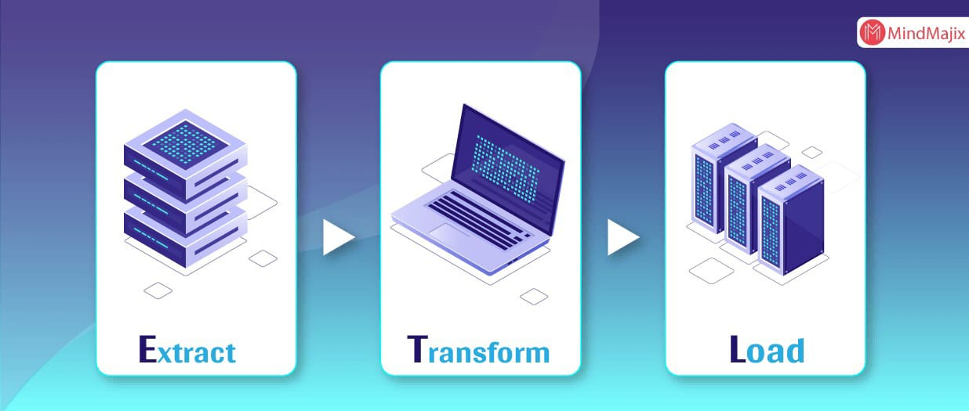
INTRODUCTION TO ETL
Informatica ETL is the most commonly used Data integration tool used for connecting & fetching data from different data sources.
Informatica - tool is implemented Through ETL (Extract, Transform, Load)
ETL, which stands for extract, transform and load, is a data integration process that combines data from multiple data sources into a single, consistent data store that is loaded into a data warehouse or other
target system.

Slide 6
FEATURES AND CHARACTERISTICS OF ETL TOOL
Parallel Processing
2. Data Reuse, Data Re-Run, and Data Recovery
3. Visual ETL
CHARACTERISTICSS
It should increase data connectivity and scalability.
It should be capable of connecting multiple relational databases.
It should support even csv-datafiles so that end users can import these files with less code or no code.
It should have a user-friendly GUI that makes end-users easily integrate the data with the visual mapper.
It should allow the end-users to customize the data modules as per their business needs.

Slide 7
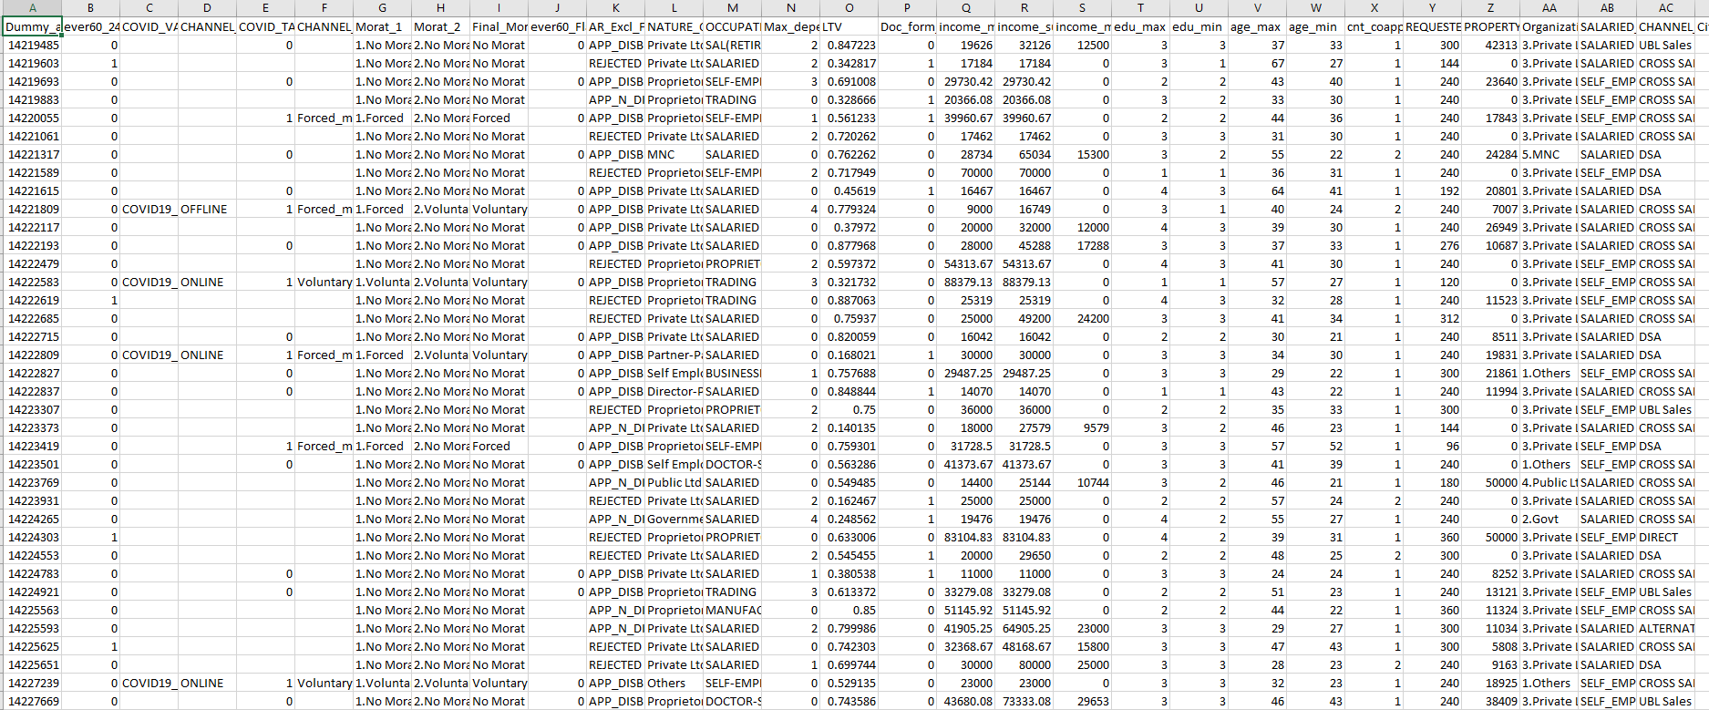
DATA PREVIEW

Slide 8
STEPS
CONVERT THE GIVEN CSV DATASET TO TXT FILE
IMPORT THE TXT DATASET IN THE SOURCE ANALYSER OF THE POWER CENTER DESIGNER
CREATE TARGET TABLE
MAPPING IS DONE IN MAPPING DESIGNER(TRANSFORMATIONS ARE USED HERE)
WORKFLOW IS DONE IN WORK FLOW MANAGER
THE STATUS OF WORKFLOW IS SHOWN IN WORKFLOW MONITOR
AFTER SUCCESSFUL COMPLETION OF WORKFLOW REQUIRED OUTPUT IS OBTAINED

Slide 9
SCENARIOS
CONFIGURE THE SOURCE AND TARGET CONNECTIONS
IMPLEMENT RANK AND ROUTER TRANSFORMATIONS USING ETL
IMPLEMENT AGGREGATE AND FILTER TRANS USING ETL
IMPLEMENT FLAT FILE TRANSFERING TO TARGET USING AGGREGATION
CREATE DIFFERENT SOURCES & TARGETS INTEGRATE WITH ETL

Slide 10
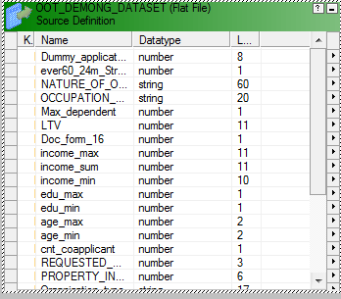
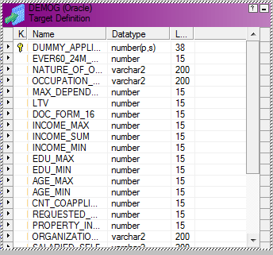
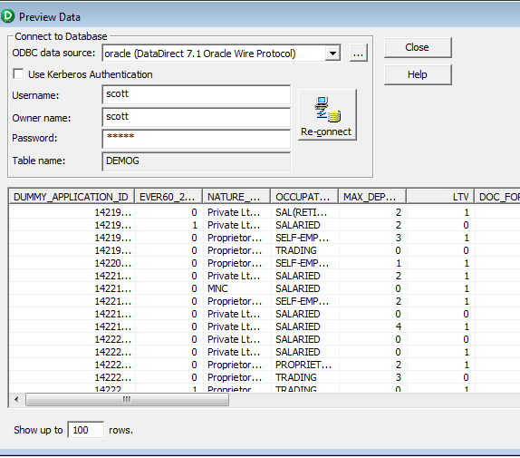
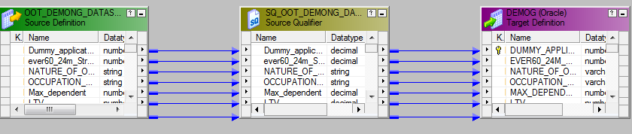
SCN 1: CONFIGURE THE SOURCE AND TARGET CONNECTIONS
SOURCE
TARGET
OUTPUT
MAPPING :

Slide 11
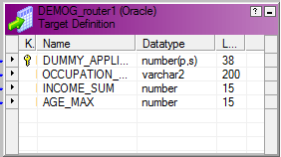
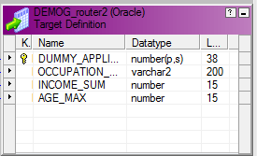
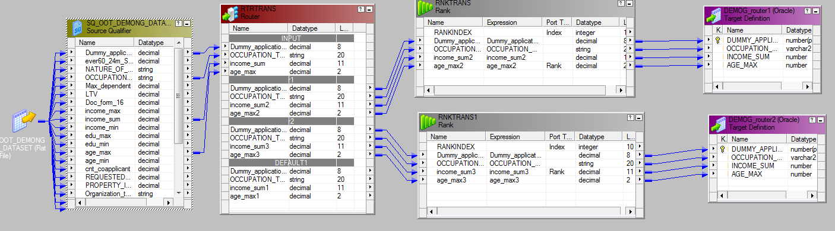
SCN 2 : IMPLEMENT Rank AND router TRANSFORMATIONS USING ETL
TARGET 1
TARGET 2
MAPPINGS :

Slide 12
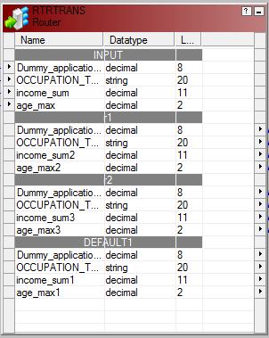
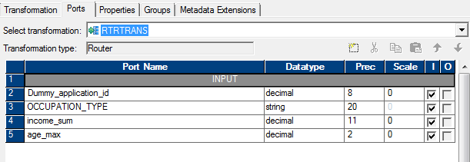
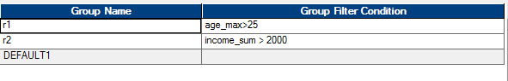
TRANSFORMATIONS
RTR TRANS

Slide 13
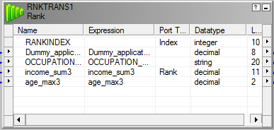
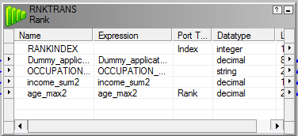
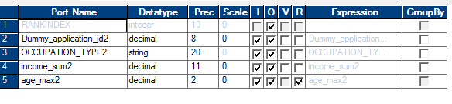
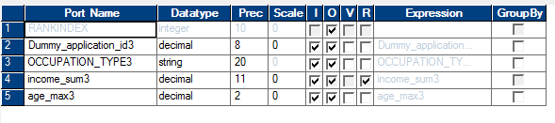
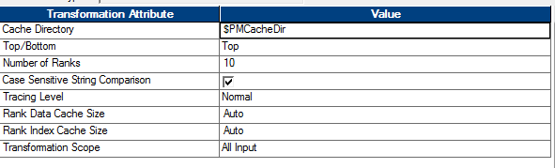
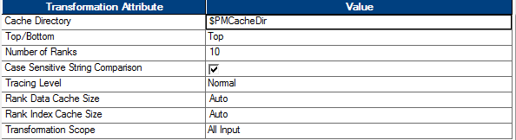
RANK TRANSFORMATIONS

Slide 14
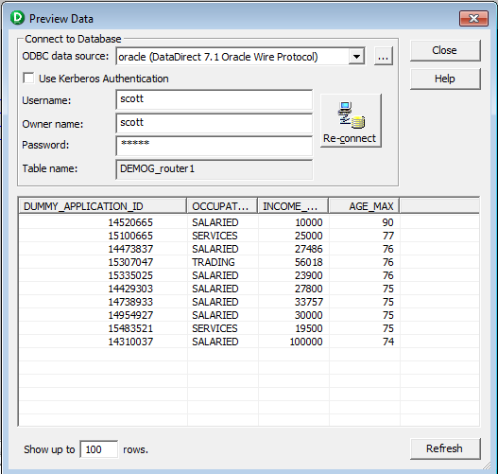
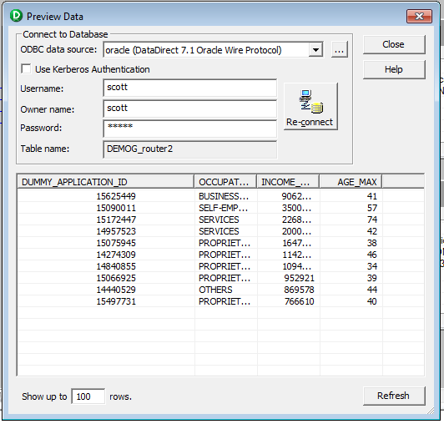
OUTPUTS : SCN 2
OUTPUT 1
OUTPUT 2

Slide 15
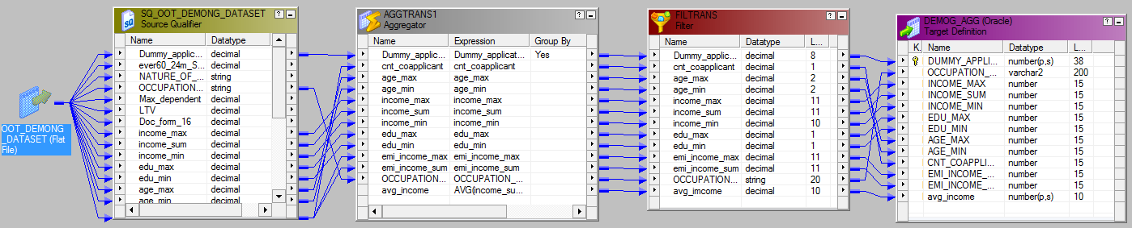
SCN 3 : IMPLEMENT AGGREGATE AND FILTER TRANS USING ETL
MAPPING USING AGG AND FILTER TRANS :

Slide 16
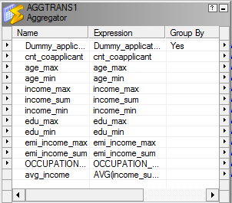
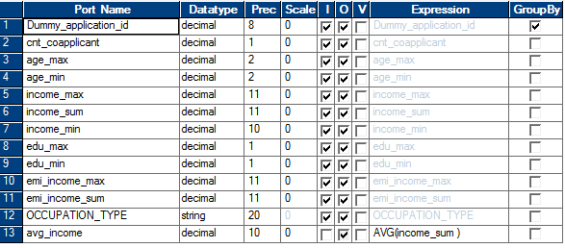
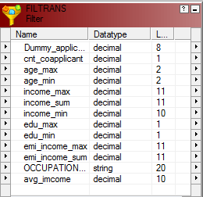
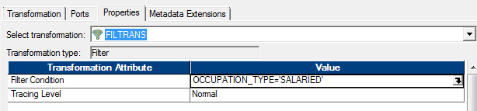
TRANSFORMATIONS
AGG TRANS
FILTER TRANS

Slide 17
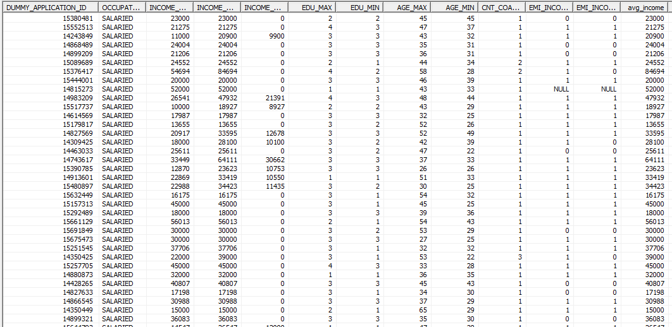
OUTPUT : SCN 3

Slide 18
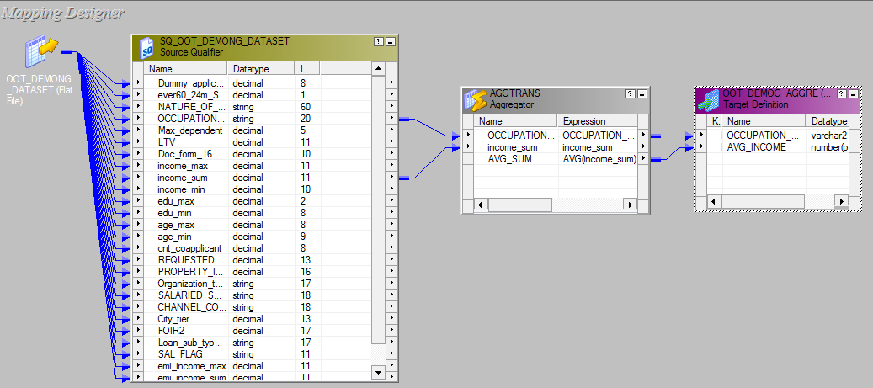
SCN 4 : IMPLEMENT FLAT FILE TRANSFERING TO TARGET USING AGGREGATION
MAPPING :

Slide 19
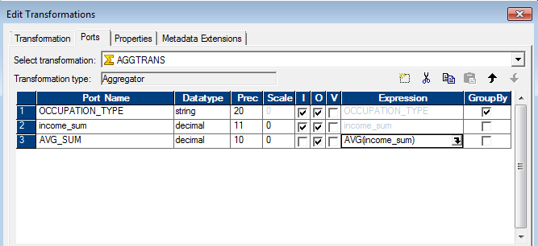
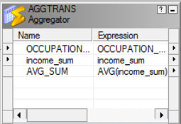
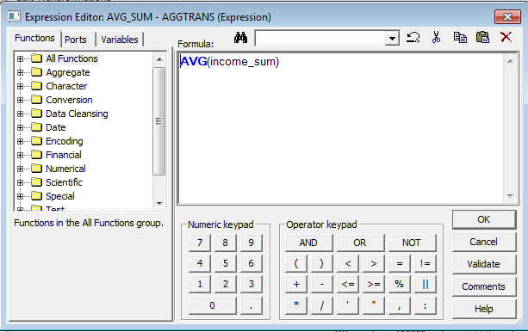
AGG TRANSFORMATION

Slide 20
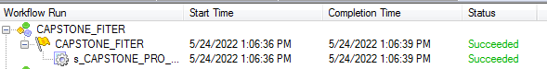
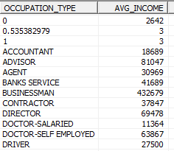
OUTPUT : SCN 4
WORKFLOW RUN
OUTPUT

Slide 21
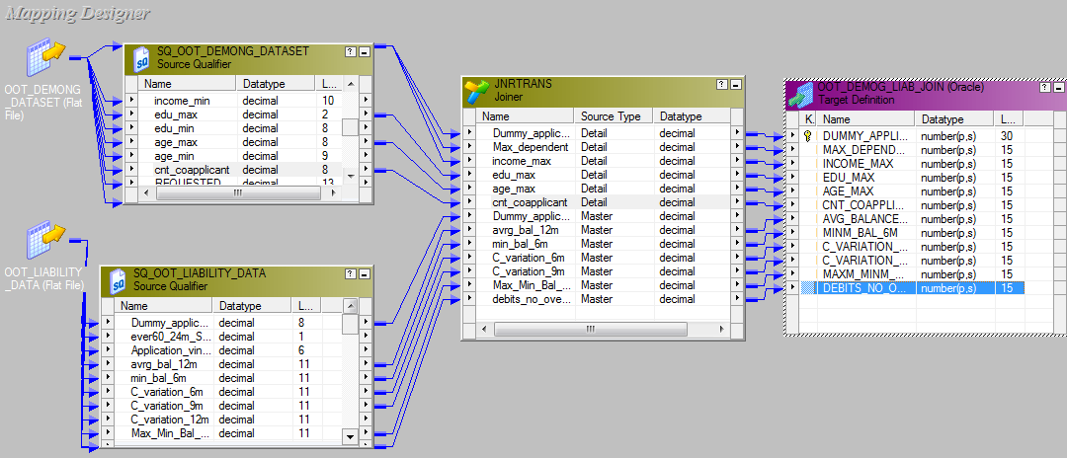
SCN 5 : CREATE DIFFERENT SOURCES & TARGETS INTEGRATE WITH ETL
MAPPING :

Slide 22
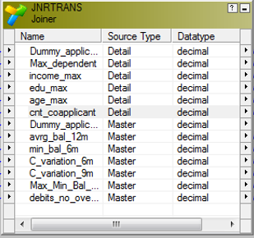
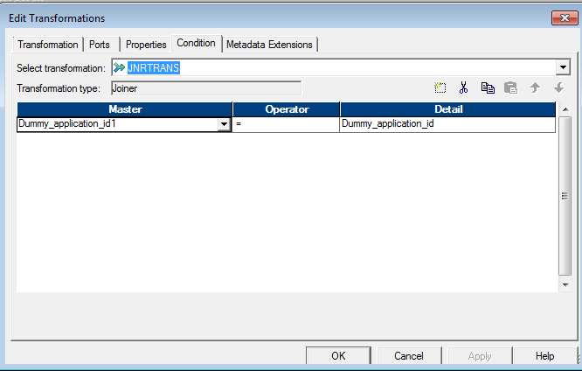
JOIN TRANS

Slide 23
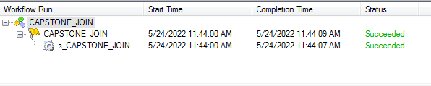
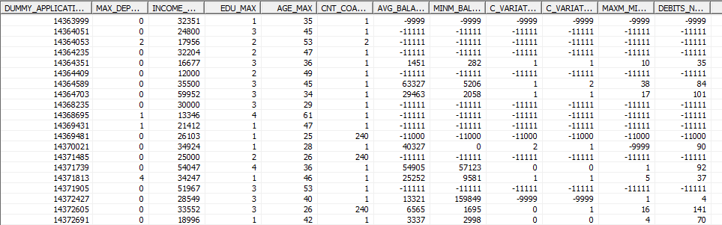
OUTPUT : SCN 5
WORKFLOW RUN
OUTPUT

Slide 24
SPARK SQL

Slide 25
STEPS
IMPORT LIBRARIES
IMPORT THE DATASET FROM HDFS
CREATE TEMP TABLES
RUN THE QUERIES
SAVE THE OUTPUT INTO HDFS

Slide 26
SCENARIOS
Show Applicant id, income_sum, and property_insurance_amt in the decreasing order of property_insurance_amt (uses OOT Demog Info Affordable Home Loans)
Find the sum of Property_Insurance_amt based on Loan sub_type (uses OOT Demog Info Affordable Home Loans)
Find the maximum and minimum of Property_Insurance_amt based on channel code. (uses OOT Demog Info Affordable Home Loans)
Find the application ids whose income sum is more than 100000 and sort it in descending order. (uses OOT Demog Info Affordable Home Loans)
Print Applicant id, income_sum, property_insurance_amt, and requested tenure where 20 <= requested tenure <= 50 and is in descending order of income sum. (uses OOT Demog Info Affordable Home Loans)
Find max of Max Delinquency in Home Loan trades in last 24m per Nature of Organization (uses OOT Demog Info Affordable Home Loans and OOT Bureau Info Affordable Home Loans)

Slide 27
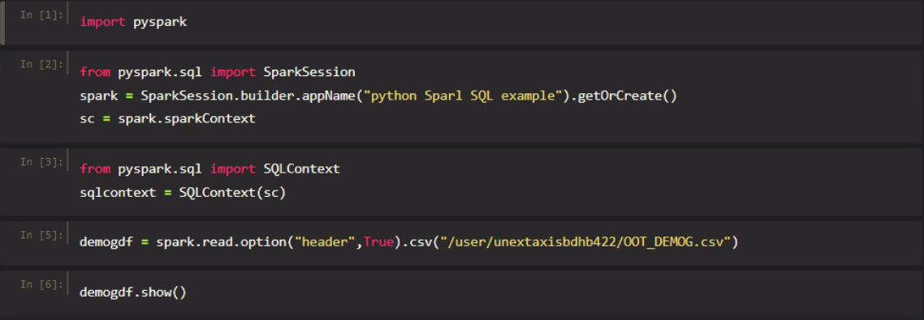
IMPORTING LIBRARIES

Slide 28
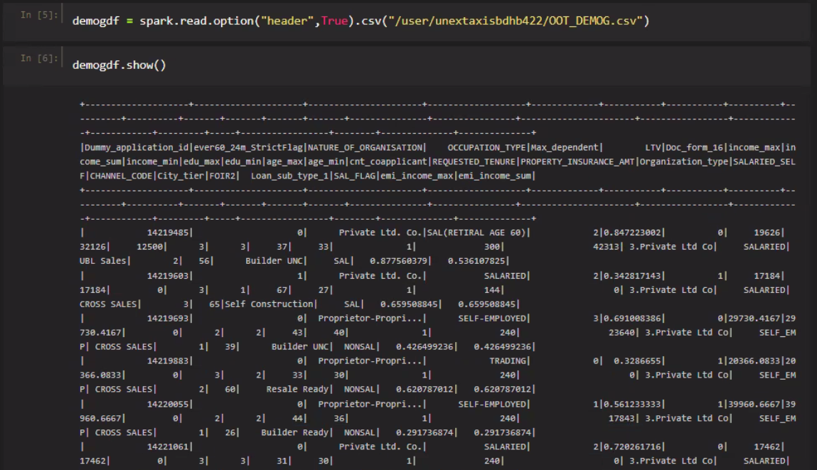
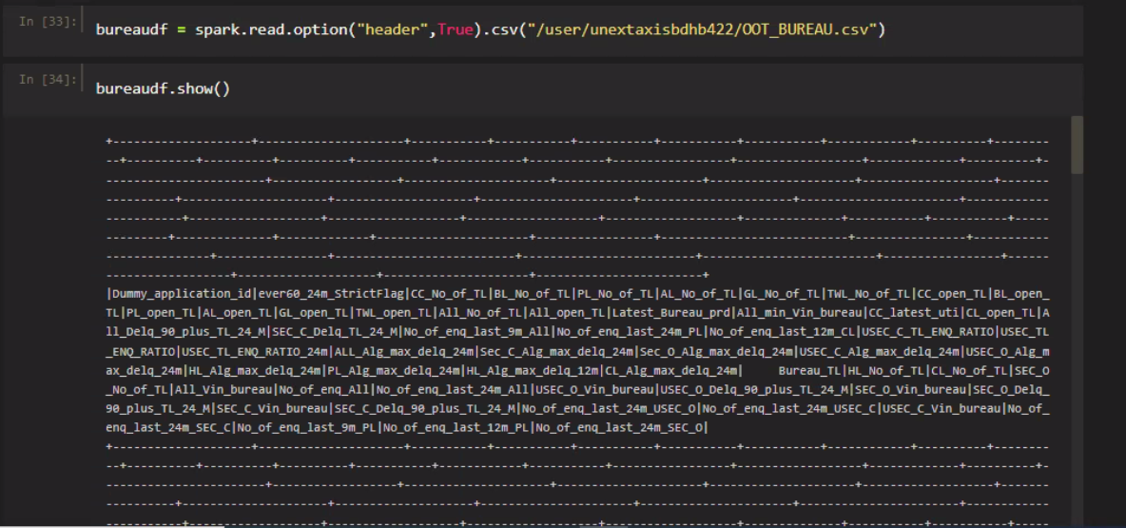
IMPORTING DATASETS
DATASET 1- DEMOG
DATASET 2- BUREAU

Slide 29
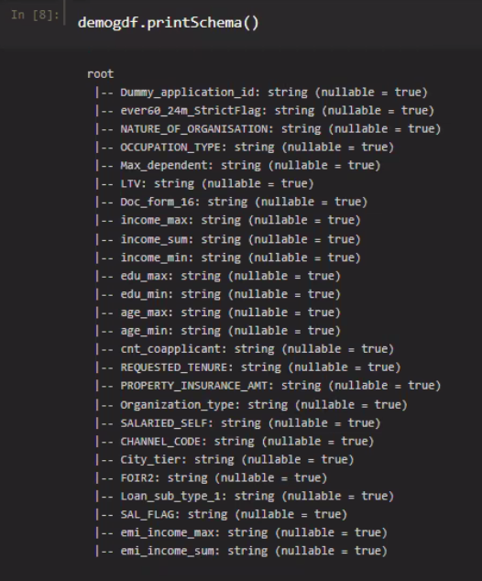
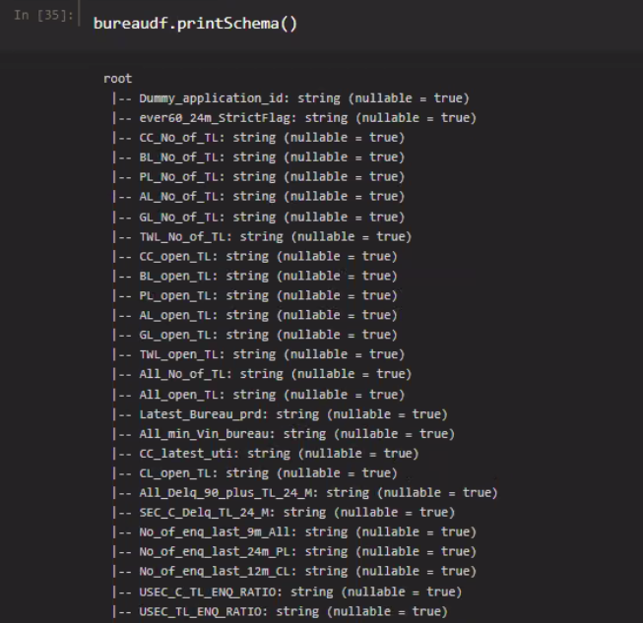
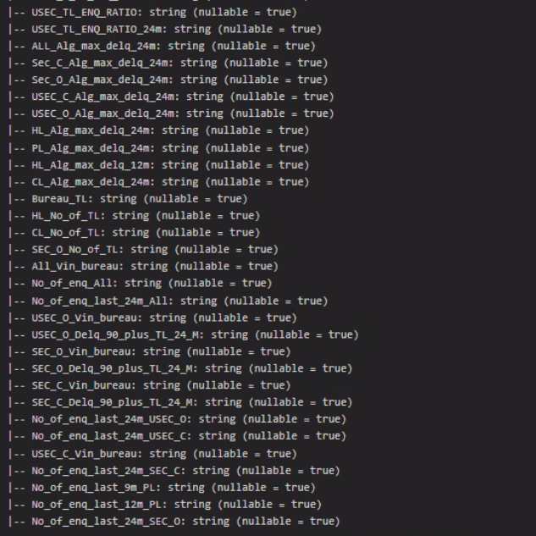
SCHEMAS OF DATASETS
DATASET 1- DEMOG
DATASET 2- BUREAU

Slide 30
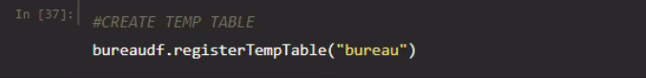
CREATING TEMPERORY TABLE OF EACH DATASET
DATASET 1- DEMOG
DATASET 2- BUREAU

Slide 31
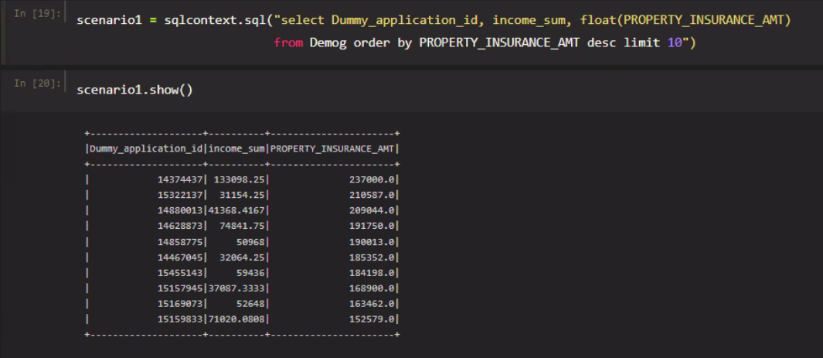
SCN 1: Show Applicant id, income_sum, and property_insurance_amt in the decreasing order of property_insurance_amt (uses OOT Demog Info Affordable Home Loans)

Slide 32
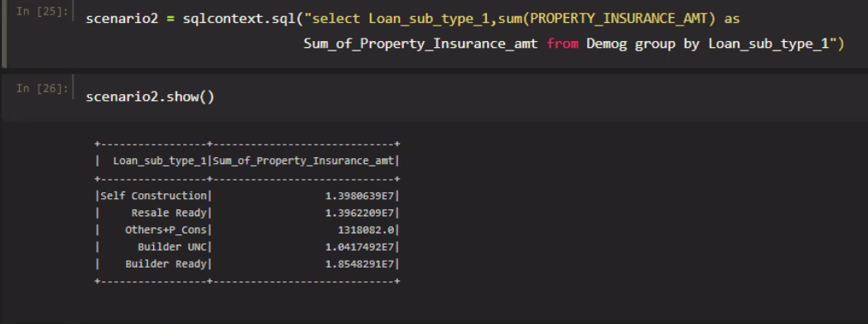
SCN 2 : Find the sum of Property_Insurance_amt based on Loan sub_type (uses OOT Demog Info Affordable Home Loans)

Slide 33
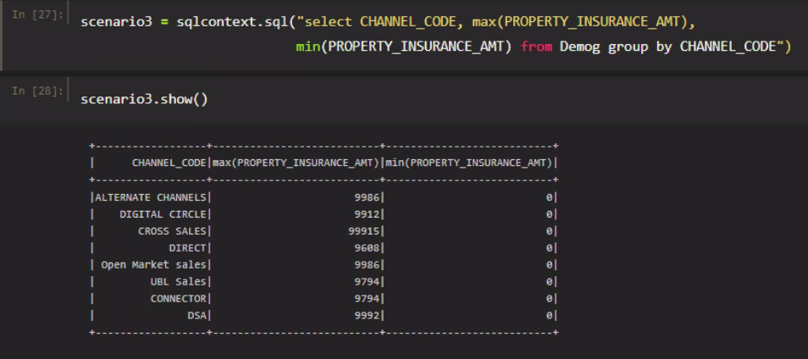
SCN 3:Find the maximum and minimum of Property_Insurance_amt based on channel code. (uses OOT Demog Info Affordable Home Loans)

Slide 34
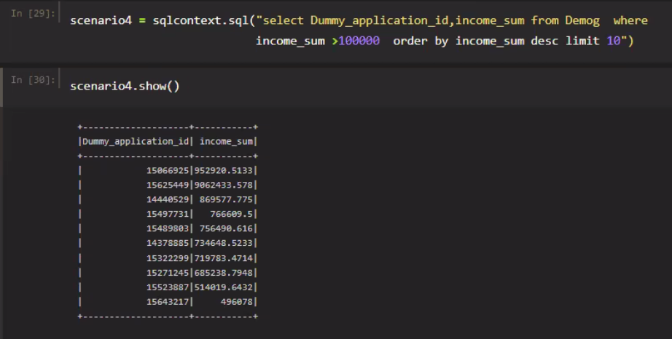
SCN 4 : Find the application ids whose income sum is more than 100000 and sort it in descending order. (uses OOT Demog Info Affordable Home Loans)

Slide 35
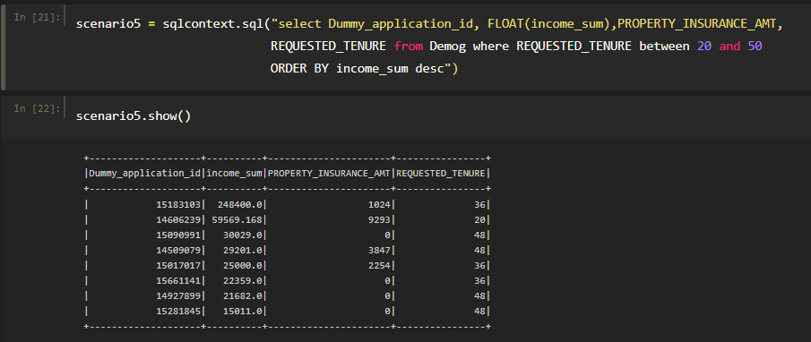
SCN 5 : Print Applicant id, income_sum, property_insurance_amt, and requested tenure where 20 <= requested tenure <= 50 and is in descending order of income sum. (uses OOT Demog Info Affordable Home Loans

Slide 36

SCN 6: Find max of Max Delinquency in Home Loan trades in last 24m per Nature of Organization (uses OOT Demog Info Affordable Home Loans and OOT Bureau Info Affordable Home Loans)

Slide 37


SAVING THE TABLES INTO HDFS
WRITING THE TABLES TO HDFS
TABLES STORED IN HDFS

Slide 38
PYSPARK

Slide 39

IMPORTING LIBRARIES

Slide 40



IMPORTING DATASETS
DEMOG
BUREAU
LIABILITY

Slide 41


SCN 7 : Find min of Min Current Account & Savings Account Balance in last 6m based on Occupation Type (uses OOT Demog Info Affordable Home Loans and OOT Liabilities Info Affordable Home Loans)
SYNTAX :
SELECTING REQUIRED COLUMNS :
ANALYSIS ON DF :

Slide 42
SCN 8 :Count the number of applicants that have Active Two-Wheeler Loans (uses OOT Demog Info Affordable Home Loans and OOT Bureau Info Affordable Home Loans)
SYNTAX :
ANALYSIS-1 :
ANALYSIS-2 :
RE-PARTIOTIONING AND SAVING :

Slide 43
HIVE

Slide 44



Creating table for datasets( demog, liability, bureau )
DEMOG
BUREAU
LIABILITY

Slide 45

LOADING THE DATA TO TABLES
DEMOG
BUREAU
LIABILITY

Slide 46
Scn 9 : List the Occupation Types (Distinct) which have Proportion of Branch Credit Amount to total Credit amount in the last 12 months as ‘1’. (uses OOT Demog Info Affordable Home Loans and OOT Liabilities Info Affordable Home Loans)
SYNTAX :
select distinct d.OCCUPATION_TYPE from DEMOG_TEAM_2 d FULL OUTER JOIN LIABILITY_TEAM_2 l on d.Dummy_application_id = l.Dummy_application_id where l.Prn_NW_BRN_C_AMT_12m=1;
CREATING EXTRENAL TABLE :
create external TABLE SCENARIO09 (OCCUPATION_TYPE string) row format delimited fields terminated by "," location "/user/unextaxisbdhb422/CAPSTONE_HIVE/SCENARIO09" ;
INSERT OVERWRITING :
insert overwrite table SCENARIO09 select distinct d.OCCUPATION_TYPE from DEMOG_TEAM_2 d FULL OUTER JOIN LIABILITY_TEAM_2 l on d.Dummy_application_id = l.Dummy_application_id where l.Prn_NW_BRN_C_AMT_12m=1;

Slide 47

SCN 9
OUTPUT :

Slide 48

Scn 10 : Find the count of applicants having Max Delinquency in all trades in last 24m >= 10 (uses OOT Demog Info Affordable Home Loans and OOT Bureau Info Affordable Home Loans)
SYNTAX :
select count(Dummy_applicant_id) from BUREAU_TEAM_2 where ALL_Alg_max_delq_24m >=10 ;
CREATING EXTRENAL TABLE :
create external SCENARIO10 (COUNT_OF_APPLICANTS INT) row format delimited fields terminated by "," location "/user/unextaxisbdhb422/CAPSTONE_HIVE/SCENARIO10" ;
INSERT OVERWRITING :
INSERT OVERWRITE TABLE SCENARIO10 select count(Dummy_applicant_id) from BUREAU_TEAM_2 where ALL_Alg_max_delq_24m >=10 ;
OUTPUT :

Slide 49

Scn 11 : Find the total count of applicants having 40 <= Current Account & Savings Account Vintage <= 100. (uses OOT Demog Info Affordable Home Loans and OOT Liabilities Info Affordable Home Loans)
SYNTAX :
select count(Dummy_application_id) from LIABILITY_TEAM_2 where Application_vintage>=40 and Application_vintage<=100 ;
CREATING EXTRENAL TABLE :
create external TABLE SCENARIO11 (COUNT_OF_APPLICANTS INT) row format delimited fields terminated by "," location "/user/unextaxisbdhb422/CAPSTONE_HIVE/SCENARIO11";
INSERT OVERWRITING :
INSERT OVERWRITE TABLE SCENARIO11 select count(Dummy_application_id) AS COUNT_OF_APPLICANTS from LIABILITY_TEAM_2 where Application_vintage>=40 and Application_vintage<=100 ;
OUTPUT :

Slide 50
Scn 12 : Find the relationship between Maximum number of dependents and Cash credit amount in last 6m – are they directly proportional or indirectly, explain how? (uses OOT Demog Info Affordable Home Loans and OOT Liabilities Info Affordable Home Loans)
SYNTAX :
select d.max_dependent, AVG(l.NW_CASH_C_AMT_6M) AS CASH_CREDIT_AMOUNT from DEMOG_TEAM_2 d FULL OUTER JOIN LIABILITY_TEAM_2 l ON (d.DUMMY_APPLICATION_ID = l.DUMMY_APPLICATION_ID) group by d.max_dependent;
CREATING EXTRENAL TABLE :
create external SCENARIO12 (MAX_DEPENDENT INT,CASH_CREDIT_AMOUNT FLOAT) row format delimited fields terminated by "," location "/user/unextaxisbdhb422/CAPSTONE_HIVE/SCENARIO12" ;
INSERT OVERWRITING :
INSERT OVERWRITE TABLE SCENARIO12 select d.max_dependent, AVG(l.NW_CASH_C_AMT_6M) AS CASH_CREDIT_AMOUNT from DEMOG_TEAM_2 d FULL OUTER JOIN LIABILITY_TEAM_2 l ON (d.DUMMY_APPLICATION_ID = l.DUMMY_APPLICATION_ID) group by d.max_dependent;

Slide 51

SCN 12 :
OUTPUT :

Slide 52

Scn 13 :List out the applicants that have more than 9 Business Loans Active. (uses OOT Demog Info Affordable Home Loans and OOT Bureau Info Affordable Home Loans)
SYNTAX :
select Dummy_application_id, BL_open_TL from BUREAU_TEAM_2 where BL_open_TL >9 ORDER BY BL_open_TL DESC;
OUTPUT :
SORTED
NO RESULTS

Slide 53

Scn 14 : Find the total count of applicants having 20 <= Gold Loans Active Tradeline <= 50. (uses OOT Demog Info Affordable Home Loans and OOT Bureau Info Affordable Home Loans)
SYNTAX :
select COUNT(gl_open_tl) from BUREAU_TEAM_2 WHERE GL_OPEN_TL BETWEEN 20 and 50;
OUTPUT :
SORTED
NO RESULTS

Slide 54
Scn 15 : Does every Nature of Organization have proportion of Cash credit count to total credit count in last 6m >=0.7? If not, list out the Nature of Organization’s which don’t have >=0.7. (uses OOT Demog Info Affordable Home Loans and OOT Liabilities Info Affordable Home Loans)
SYNTAX :
select distinct d.Nature_of_organisation from DEMOG_TEAM_2 d FULL OUTER JOIN LIABILITY_TEAM_2 l ON (d.Dummy_application_id = l.Dummy_application_id) WHERE l.Prn_NW_CASH_C_No_6m >=0.7;
CREATING EXTRENAL TABLE :
create external TABLE SCENARIO15 (NATURE_OF_ORGANISATION STRING) row format delimited fields terminated by "," location "/user/unextaxisbdhb422/CAPSTONE_HIVE/SCENARIO15";
INSERT OVERWRITING :
INSERT OVERWRITE TABLE SCENARIO15 select distinct d.Nature_of_organisation from DEMOG_TEAM_2 d FULL OUTER JOIN LIABILITY_TEAM_2 l ON (d.Dummy_application_id = l.Dummy_application_id) WHERE l.Prn_NW_CASH_C_No_6m >=0.7 ;

Slide 55

SCN 15 :
OUTPUT :

Slide 56
Scn 16 : Find the applicant id’s where Ratio of Max to Min Current Account & Savings Account balance in last 9m <= 2 and >= 10000 and sort by income sum. (uses OOT Demog Info Affordable Home Loans and OOT Liabilities Info Affordable Home Loans)
SYNTAX :
select distinct d.Dummy_application_id, d.income_sum, l.max_min_bal_ratio_9m from DEMOG_TEAM_2 d FULL OUTER JOIN LIABILITY_TEAM_2 l ON (d.Dummy_application_id = l.Dummy_application_id) where l.max_min_bal_ratio_9m between 2 and 10000 order by d.income_sum desc;
CREATING EXTRENAL TABLE :
create external TABLE SCENARIO16 (DUMMY_APPLICATION_ID INT,INCOME_SUM FLOAT,MAX_MIN_BALANCE_RATIO FLOAT) row format delimited fields terminated by "," location "/user/unextaxisbdhb422/CAPSTONE_HIVE/SCENARIO16" ;
INSERT OVERWRITING :
INSERT OVERWRITE TABLE SCENARIO16 select distinct d.Dummy_application_id, d.income_sum, l.max_min_bal_ratio_9m from DEMOG_TEAM_2 d FULL OUTER JOIN LIABILITY_TEAM_2 l ON (d.Dummy_application_id = l.Dummy_application_id) where l.max_min_bal_ratio_9m between 2 and 10000 order by d.income_sum desc;

Slide 57

SCN 16 :
OUTPUT :

Slide 58

TABLES STORED INTO HDFS

Slide 59
SPARK MLIB

Slide 60


IMPORTING LIBRARIES
LIBRARIES :
DEFINING SPARK CORE :

Slide 61


Loading TEST AND TRAIN DATAset

Slide 62


CHECKING NULL VALUES IN TEST AND TRAIN DATA
TRAIN :
TEST :

Slide 63


Converting spark df to pandas df
TRAIN :
TEST :

Slide 64


ELIMINATING NULL VALUES (TRAIN)

Slide 65


ELIMINATING NULL VALUES (TEST)

Slide 66


Selection of particular features
DEFINING TRAIN AND TEST DATA FOR MODELLING
SCHEMA OF TRAIN AND TEST DATA

Slide 67




Train and test data FOR MODELLING
TRAIN :
TEST :

Slide 68

STANDARDISING

Slide 69


Prediction OF INCOME SUM

Slide 70

Evaluation of model

Slide 71
THANK YOU
GROUP 1 – TEAM 2

